Slide 1
Protein sequence design
Introducing ProteinMPNN…

Slide 2
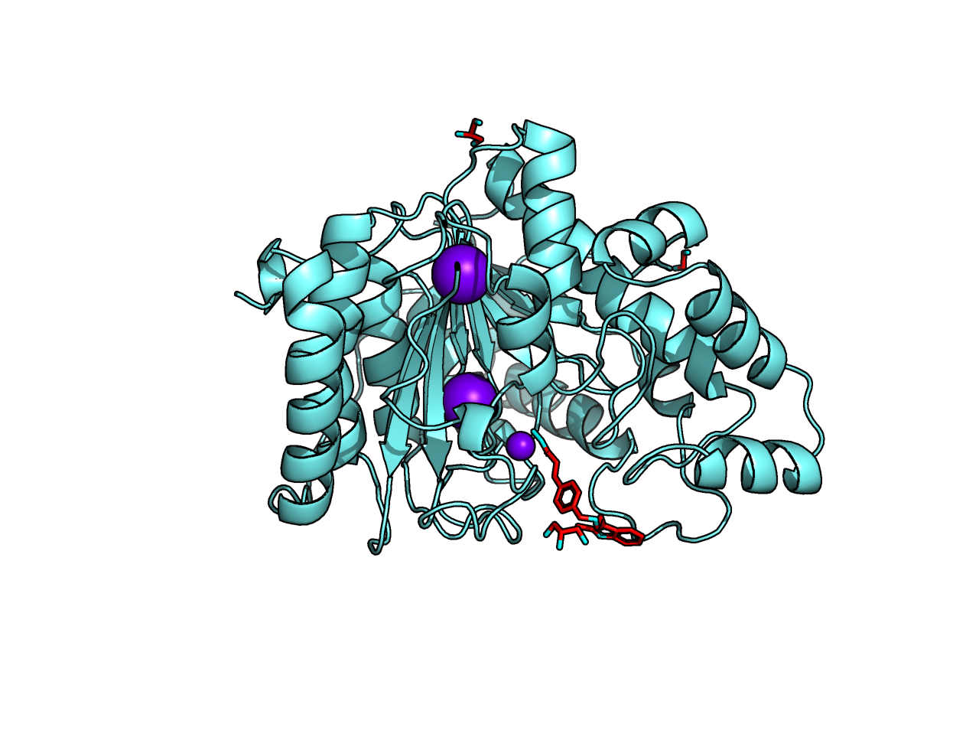
We covered protein structure prediction
ILVEPRTEINS…

Slide 3
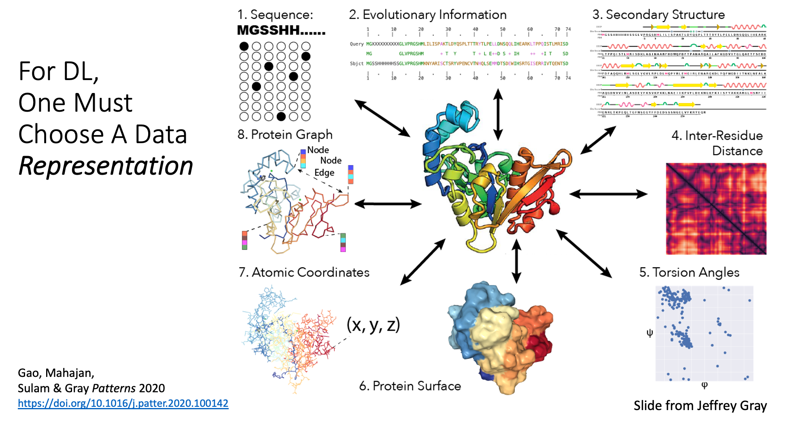
Common data representations for proteins in machine learning
Gao, Mahajan, Sulam & Gray Patterns 2020
https://doi.org/10.1016/j.patter.2020.100142

Slide 4
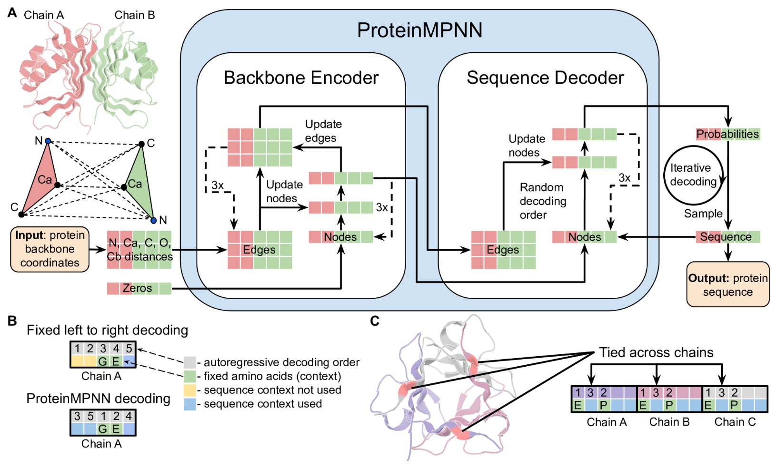
ProteinMPNN predicts protein sequences given a backbone structure

Slide 5
The MPNN architecture built for protein design by John Ingraham et al.
Ingraham, et al., NeurIPS 2019
https://proceedings.neurips.cc/paper_files/paper/2019/file/f3a4ff4839c56a5f460c88cce3666a2b-Paper.pdf

Slide 6
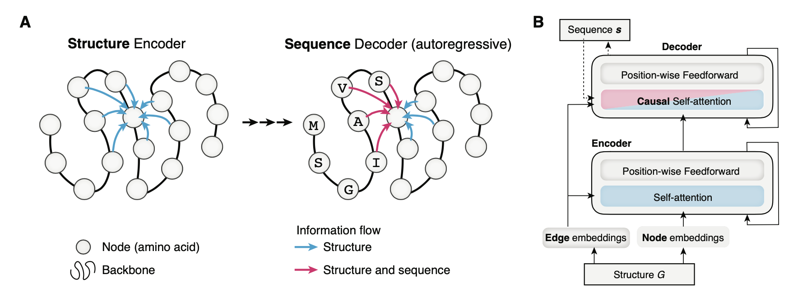
The MPNN architecture built for protein design by John Ingraham et al.
Ingraham, et al., NeurIPS 2019
https://proceedings.neurips.cc/paper_files/paper/2019/file/f3a4ff4839c56a5f460c88cce3666a2b-Paper.pdf

Slide 7
The MPNN architecture built for protein design by John Ingraham et al.
Ingraham, et al., NeurIPS 2019
https://proceedings.neurips.cc/paper_files/paper/2019/file/f3a4ff4839c56a5f460c88cce3666a2b-Paper.pdf

Slide 8
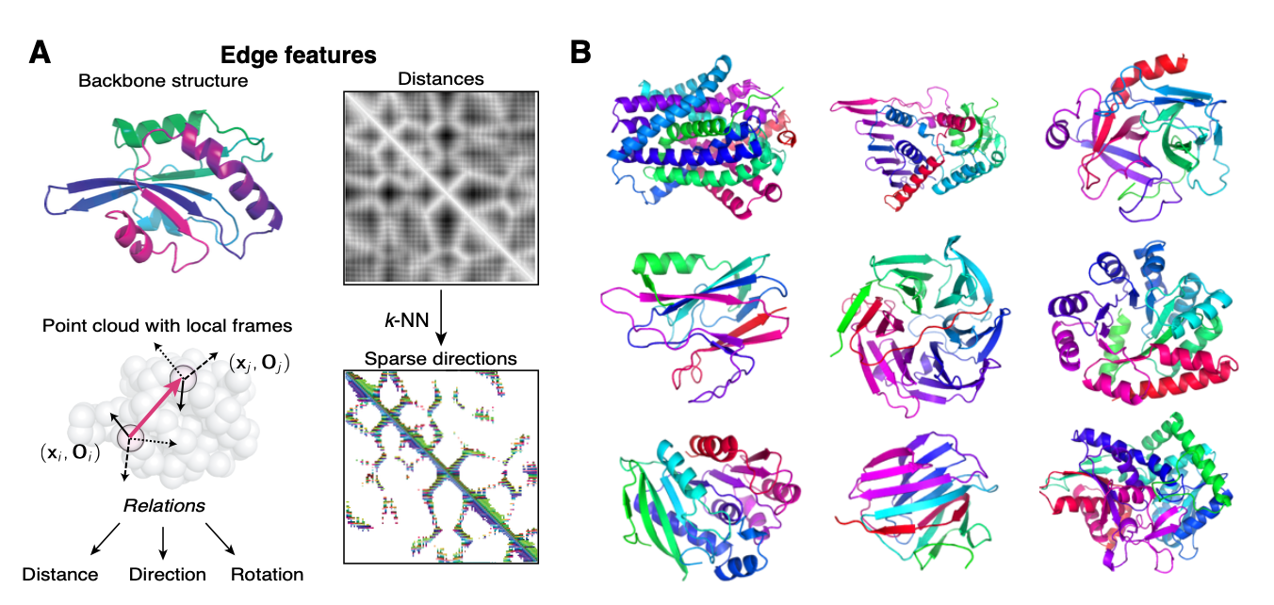
The MPNN architecture built for protein design by John Ingraham et al.
Ingraham, et al., NeurIPS 2019
https://proceedings.neurips.cc/paper_files/paper/2019/file/f3a4ff4839c56a5f460c88cce3666a2b-Paper.pdf

Slide 9
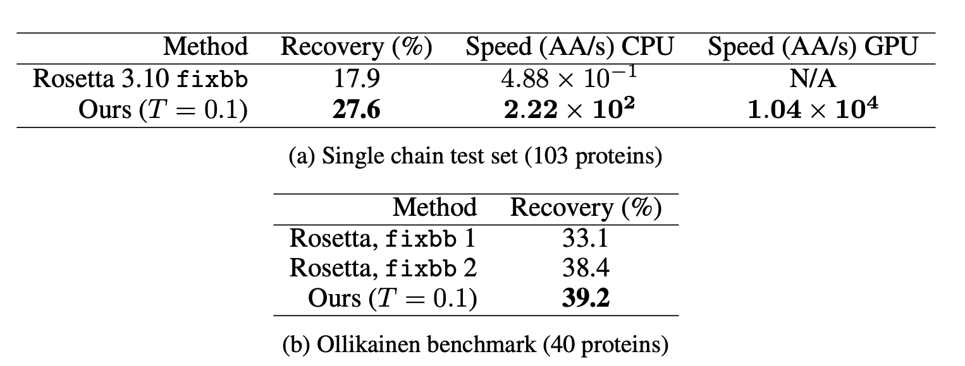
The MPNN architecture built for protein design by John Ingraham et al.
Ingraham, et al., NeurIPS 2019
https://proceedings.neurips.cc/paper_files/paper/2019/file/f3a4ff4839c56a5f460c88cce3666a2b-Paper.pdf

Slide 10
ProteinMPNN predicts protein sequences given a backbone structure

Slide 11
ProteinMPNN predicts protein sequences given a backbone structure

Slide 12
ProteinMPNN predicts protein sequences given a backbone structure

Slide 13
ProteinMPNN predicts protein sequences given a backbone structure

Slide 14
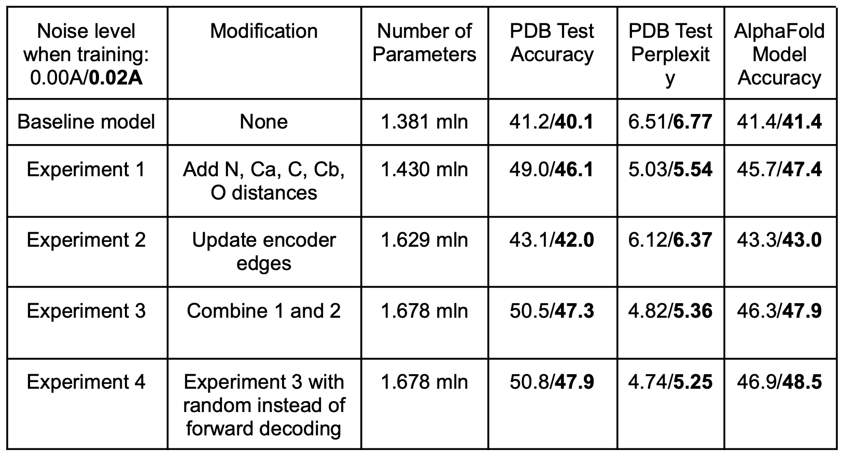
ProteinMPNN performance breakdown – single chain
Dauparas, et al., Science 2022
https://www.science.org/doi/10.1126/science.add2187

Slide 15
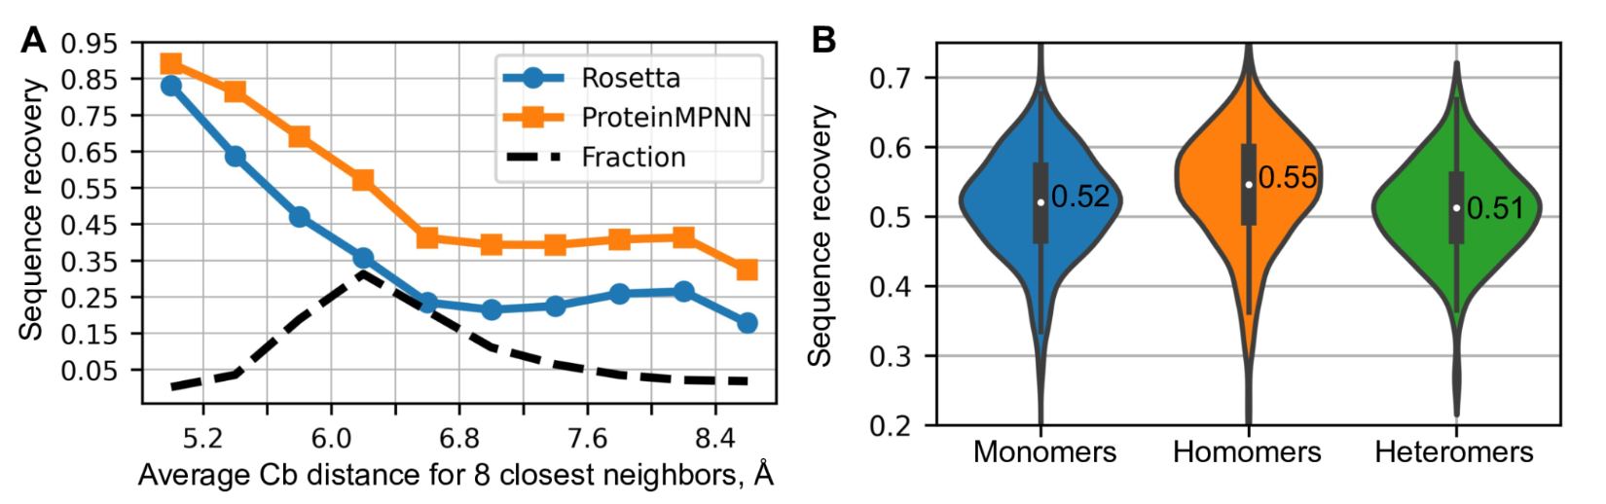
ProteinMPNN performance
Dauparas, et al., Science 2022
https://www.science.org/doi/10.1126/science.add2187

Slide 16
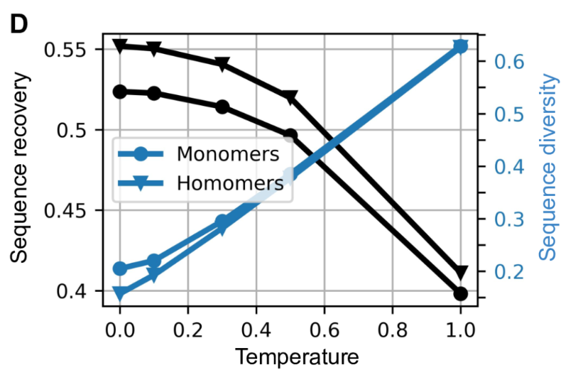
Increasing ProteinMPNN sampling temperature increases sequence diversity (and entropy)
Dauparas, et al., Science 2022
https://www.science.org/doi/10.1126/science.add2187

Slide 17
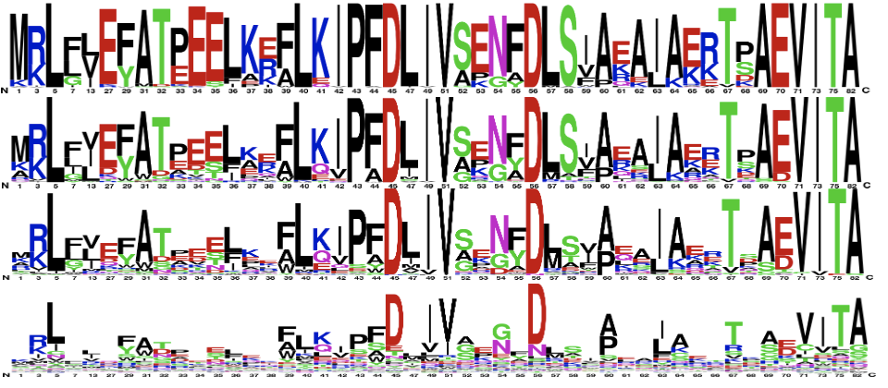
Increasing ProteinMPNN sampling temperature increases sequence diversity (and entropy)
0.1
T
1.0
Dauparas, et al., Science 2022
https://www.science.org/doi/10.1126/science.add2187

Slide 18
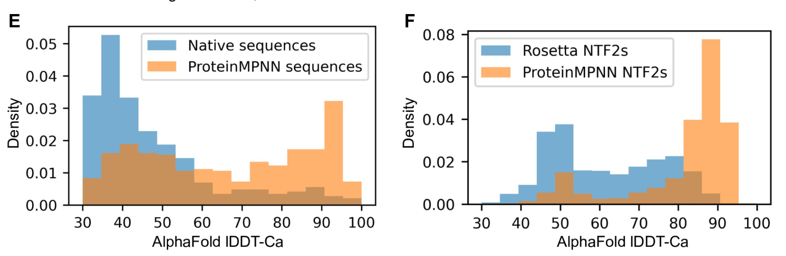
AlphaFold performance on ProteinMPNN sequences
Dauparas, et al., Science 2022
https://www.science.org/doi/10.1126/science.add2187

Slide 19
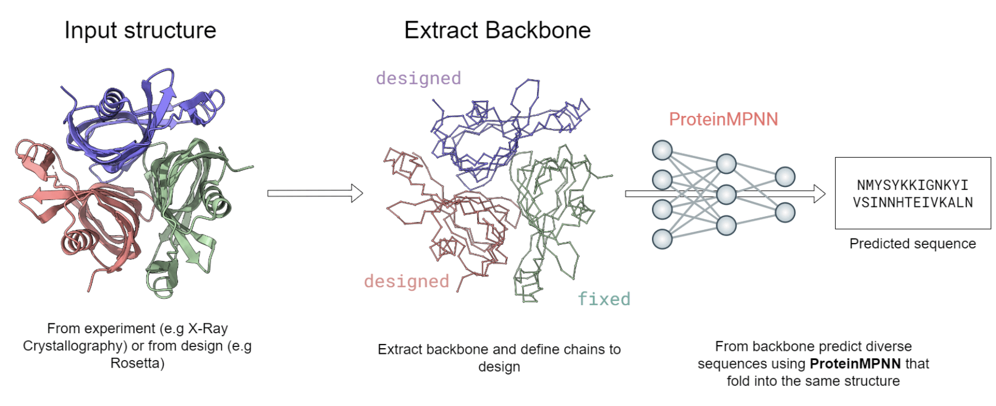
ProteinMPNN can design on multi-chain pdbs
Figure from Simon Duerr

Slide 20
ProteinMPNN Demonstration

Slide 21
ProteinMPNN Demonstration
search “proteinmpnn hugging face” or go to https://huggingface.co/spaces/simonduerr/ProteinMPNN

Slide 22
Slide credits
Deniz Akpinaroglu

